Slide 1

Exchange Online Administration
Basics of managing Exchange Online
Notes:
In this presentation, we will explore the basics of Exchange Online administration. We will cover the roles and responsibilities of an Exchange Online administrator, best practices for managing Exchange Online, and tips for ensuring optimal performance and security.

Slide 2

Overview of Exchange Online Administration
Exchange Online Overview
Exchange Online is a cloud-based email and calendaring service that is part of Microsoft's Office 365 suite of applications. It provides a secure and reliable platform for users to access their email, calendar and contacts from anywhere.
User Account Management
Exchange Online administrators are responsible for creating and managing user accounts, including assigning Exchange Online licenses, resetting passwords, and managing mailbox permissions.
Policy and Setting Configuration
Exchange Online administrators can configure policies and settings to control how users access and use the service, including setting mailbox size limits, configuring retention policies, and enabling/disable features.
Troubleshooting Issues
Exchange Online administrators are responsible for troubleshooting and resolving user issues, including mailbox access issues, performance problems, and mail delivery issues.
Notes:
Exchange Online is a cloud-based email and calendaring service that is part of Microsoft's Office 365 suite of applications. As an Exchange Online administrator, your responsibilities include managing user accounts, configuring policies and settings, and troubleshooting issues. In this presentation, we will explore the key aspects of Exchange Online administration that you need to know.

Slide 3

Introduction to Exchange Online Administration
Exchange Online Overview
Exchange Online is a cloud-based email, calendar, and contacts service provided by Microsoft. It is part of the Office 365 family of services and provides enterprise-grade communication tools for organizations.
Exchange Online Administrator Roles
Exchange Online administrators have different roles and responsibilities depending on their assigned task. Roles include the global administrator, security administrator, compliance administrator, and more.
Best Practices for Managing Exchange Online
Managing Exchange Online requires following best practices for configuration, security, maintenance, and troubleshooting. These best practices ensure that Exchange Online remains secure and performant for users.
Notes:
In this section, we will cover the basics of Exchange Online administration. We will discuss what Exchange Online is, the different roles and responsibilities of an Exchange Online administrator, and best practices for managing Exchange Online.

Slide 4

What is Exchange Online?
Cloud-based Email Service
Exchange Online is a cloud-based email service that enables users to access their email, calendar, and contacts from any device, anywhere, and at any time.
Calendaring Service
Exchange Online is a calendaring service that enables users to create and manage their schedules, appointments, and events.
Notes:
Exchange Online is a cloud-based email and calendaring service that is part of Microsoft's Office 365 suite of applications. It allows users to access their email, calendar, and contacts from any device, anywhere, and at any time.

Slide 5

Exchange Online Administrator Roles
Exchange Online Administrator
The Exchange Online Administrator is responsible for managing user accounts, mailboxes, and distribution lists in Exchange Online.
Exchange Online Service Administrator
The Exchange Online Service Administrator is responsible for managing Exchange Online and configuring security settings.
Exchange Online Compliance Administrator
The Exchange Online Compliance Administrator is responsible for managing compliance features in Exchange Online, including eDiscovery and retention policies.
Notes:
There are several different roles and responsibilities for Exchange Online administrators, depending on the size and complexity of your organization. Some common roles include the Exchange Online administrator, the Exchange Online service administrator, and the Exchange Online compliance administrator.

Slide 6
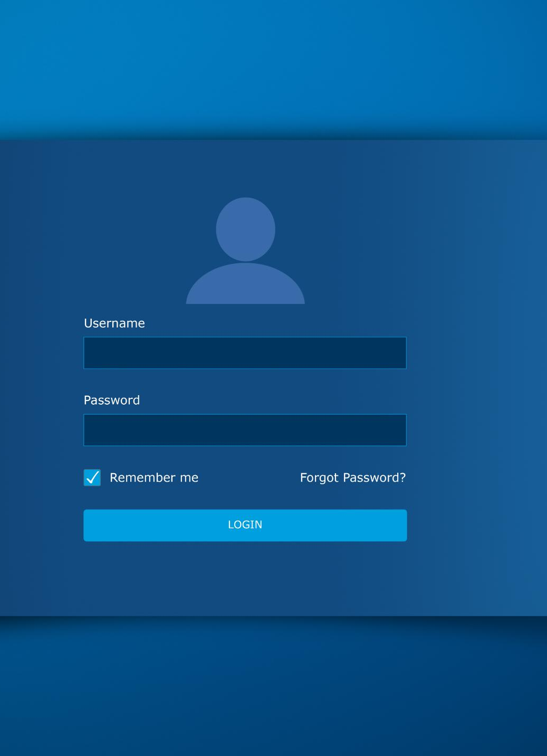
Exchange Online Management Roles and Permissions
Built-in Roles in Exchange Online
Exchange Online has several built-in management roles that can be used to assign permissions to perform specific tasks. These roles can be easily assigned or removed from users.
Creating Custom Roles in Exchange Online
Exchange Online allows administrators to create custom roles based on their specific needs. These roles can be used to delegate tasks that are not covered by the built-in roles.
Delegating Tasks in Exchange Online
Exchange Online provides a flexible way to delegate specific tasks to other administrators while ensuring security. This feature helps in reducing the workload of the IT administrator and allows them to focus on more critical tasks.
Notes:
In this section, we will explore the different built-in roles that are available in Exchange Online, as well as how to create custom roles and permissions. This will help you to delegate specific tasks to other administrators, while ensuring that the security of your Exchange Online environment is maintained.

Slide 7

Exchange Online Built-In Roles
Recipient Management Role
The Recipient Management role is a built-in role in Exchange Online that allows users to manage user accounts and mailbox permissions.
Organization Management Role
The Organization Management role is a built-in role in Exchange Online that grants full administrative access to Exchange Online, including the ability to manage users, groups, and resources.
Notes:
Exchange Online comes with several built-in roles that you can use to delegate administrative tasks to other users. Examples include the Recipient Management role, which allows users to manage user accounts, and the Organization Management role, which grants full administrative access to Exchange Online.

Slide 8
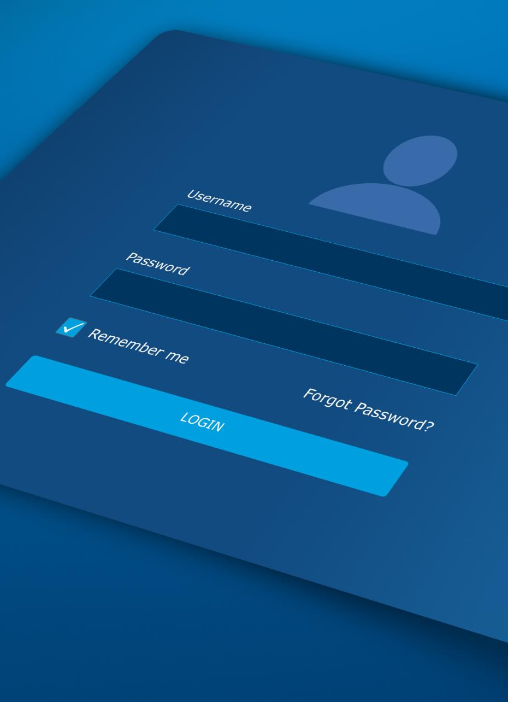
Custom Roles and Permissions
Custom Roles
You can create custom roles in Exchange Online to delegate specific tasks to users without giving them access to the entire environment. For example, you can create a custom role that allows a user to manage distribution groups, but not user accounts.
Custom Permissions
In addition to custom roles, you can also create custom permissions in Exchange Online to specify what actions a user can perform within a specific role. This allows you to grant or restrict access to specific functionality within Exchange Online.
Notes:
In addition to the built-in roles, you can also create custom roles and permissions in Exchange Online. This allows you to delegate specific tasks to users, without giving them access to the entire Exchange Online environment. For example, you can create a custom role that allows a user to manage distribution groups, but not user accounts.

Slide 9

Exchange Online Policies and Best Practices
Exchange Online Best Practices
Implementing best practices for Exchange Online management is crucial for ensuring optimal performance and security. This includes configuring appropriate policies, monitoring usage, and performing regular maintenance tasks.
Exchange Online Policies
There are several key policies and settings that you should configure to ensure security and compliance for your Exchange Online environment, including password policies, message retention policies, and encryption settings.
Notes:
In this section, we will cover some best practices for managing Exchange Online, as well as some of the key policies and settings that you should configure. This will help you to ensure optimal performance and security for your Exchange Online environment.

Slide 10

Exchange Online Retention Policies
Retention Policies in Exchange Online
Retention policies in Exchange Online allow you to keep email messages and other items for a specific period of time, based on criteria such as the age of the item or the folder where it is stored.
Compliance with Legal and Regulatory Requirements
Retention policies in Exchange Online can help you to comply with legal or regulatory requirements, such as data retention laws or industry-specific regulations.
Mailbox Management and Improved Performance
Retention policies in Exchange Online can help you to manage mailbox sizes and improve performance by automatically deleting old or unnecessary items.
Notes:
Retention policies in Exchange Online allow you to keep email messages and other items for a specific period of time, based on criteria such as the age of the item or the folder where it is stored. This can help you to comply with legal or regulatory requirements, as well as to manage mailbox sizes and improve performance.

Slide 11

Data Loss Prevention Policies
DLP Policies
Data Loss Prevention (DLP) policies in Exchange Online help you to protect sensitive information by identifying and preventing the accidental or intentional sharing of confidential data.
Detection and Blocking
You can set up DLP policies to detect and block the transmission of sensitive data, such as credit card numbers or social security numbers, in email messages.
Notes:
Data Loss Prevention (DLP) policies in Exchange Online help you to protect sensitive information by identifying and preventing the accidental or intentional sharing of confidential data. You can set up DLP policies to detect and block the transmission of sensitive data, such as credit card numbers or social security numbers, in email messages.

Slide 12


Conclusion
Exchange Online administration is a critical task for any organization that uses this service for email and calendaring. By following best practices for managing Exchange Online, as well as configuring the appropriate policies and settings, you can ensure optimal performance, security, and compliance for your environment.
Notes:
Exchange Online administration is a critical task for any organization that uses this service for email and calendaring. By following best practices for managing Exchange Online, as well as configuring the appropriate policies and settings, you can ensure optimal performance, security, and compliance for your environment.

Slide 13


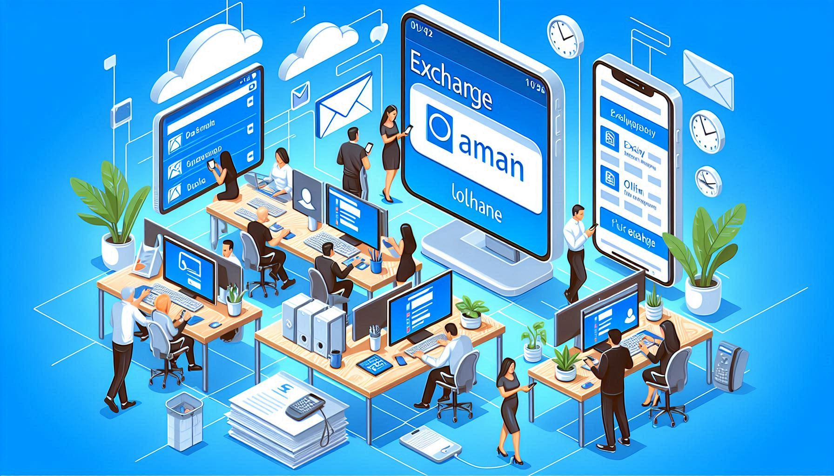
Dan Rey
http://www.linkedin.com/in/stilldrey

